Slide 1

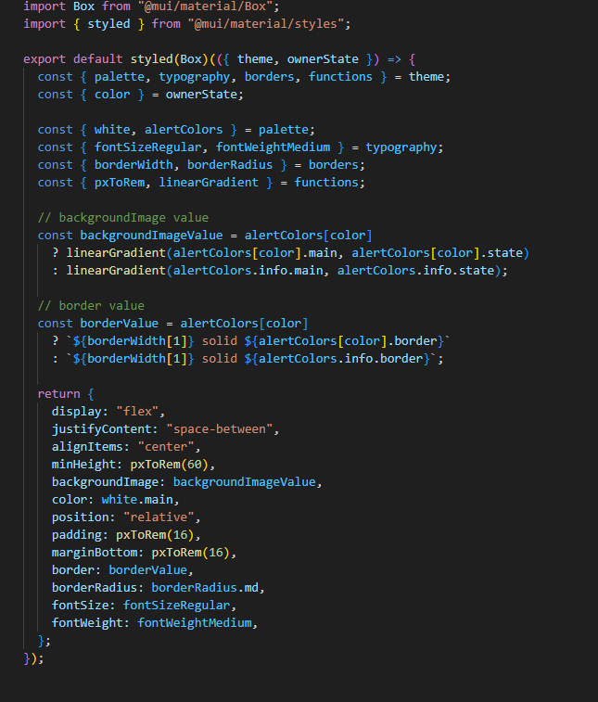
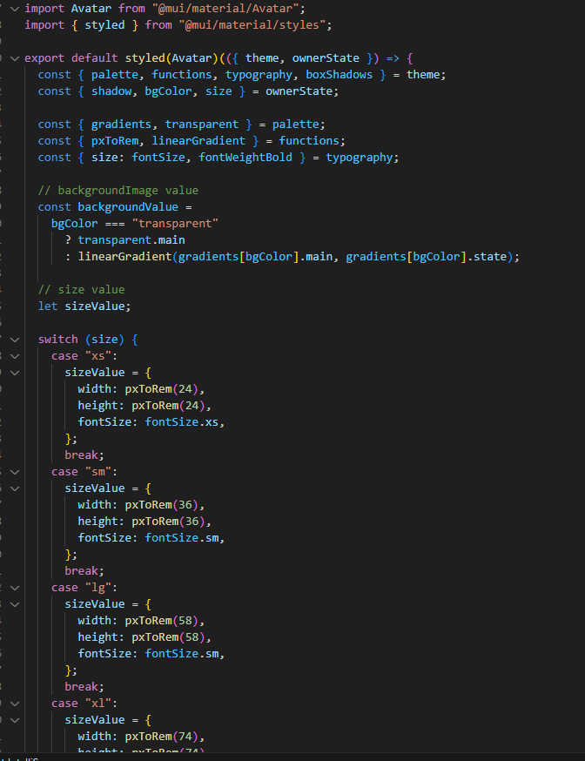
Voltiva
Voltiva is an innovative smart plug solution designed to offer users convenient control and monitoring of their electronic devices. Equipped with real-time energy monitoring, remote access, and automation features, Voltiva enables energy-saving, safety, and convenience from any mobile or web interface. Seamlessly integrating with the home ecosystem, Voltiva brings a modern touch to managing power consumption effortlessly
Technologies Used
React: A JavaScript library for building interactive, responsive user interfaces. React enables fast rendering and seamless user experiences across web applications.
Node.js: A JavaScript runtime for building scalable, server-side applications. Node.js handles backend processing efficiently, enabling smooth data flow between the front end and database.

Slide 2
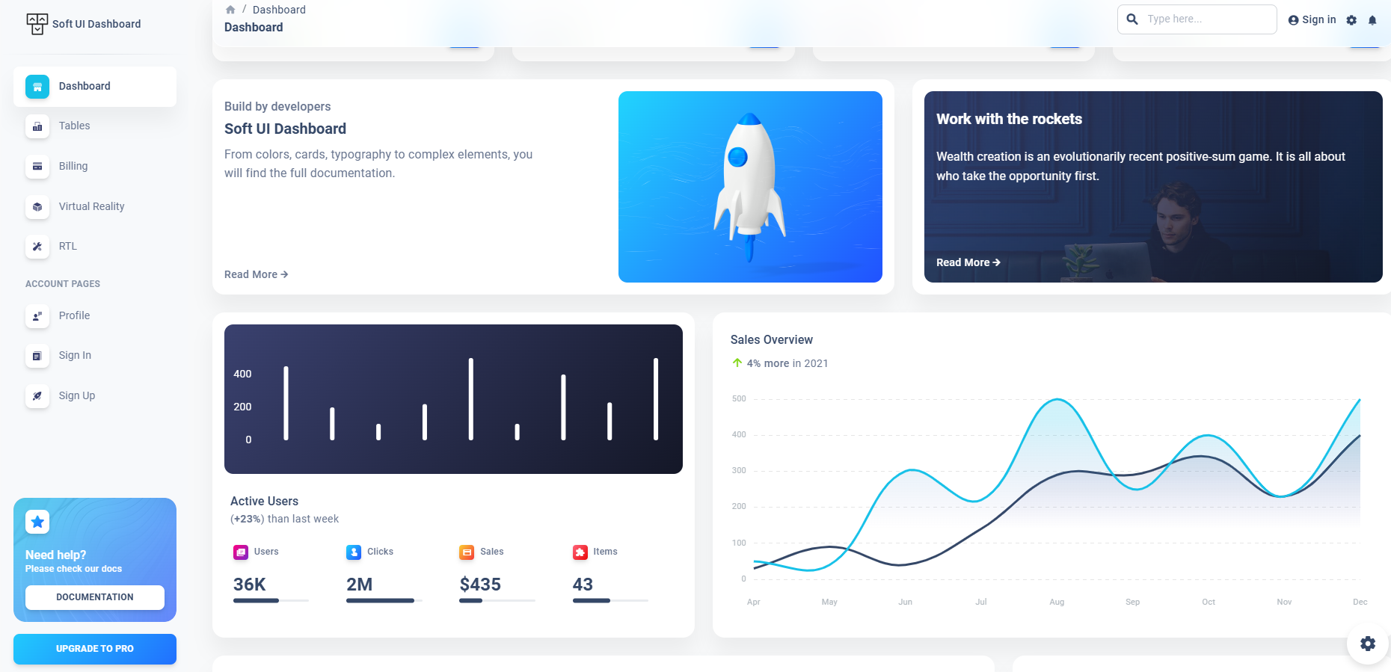
Preview

